Slide 1

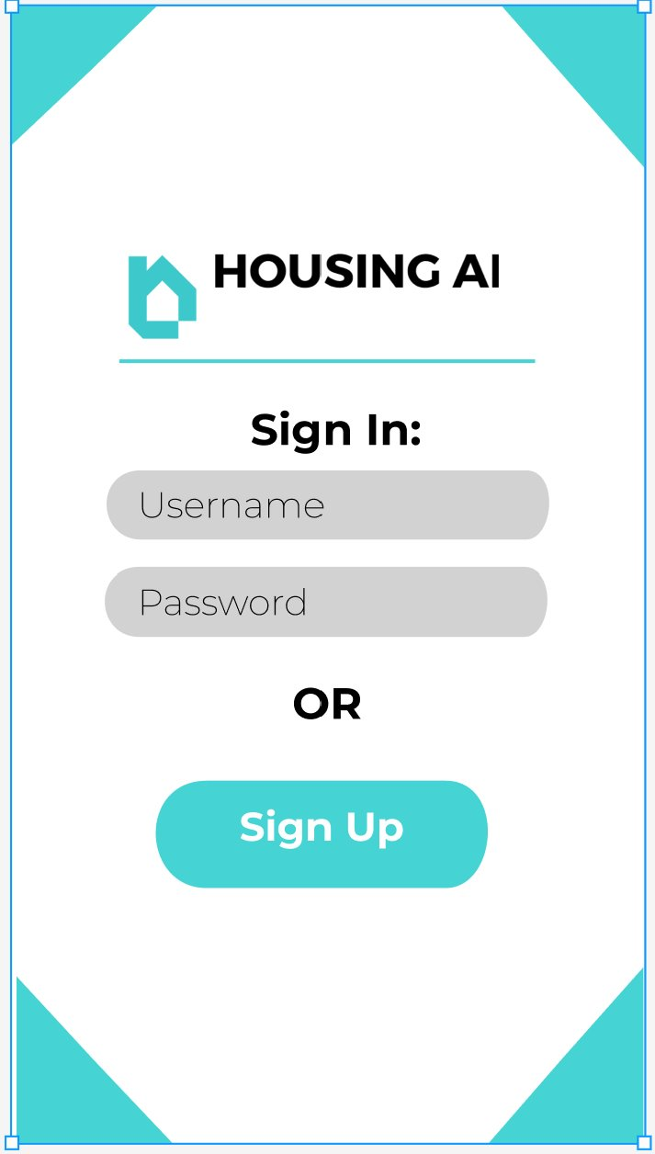
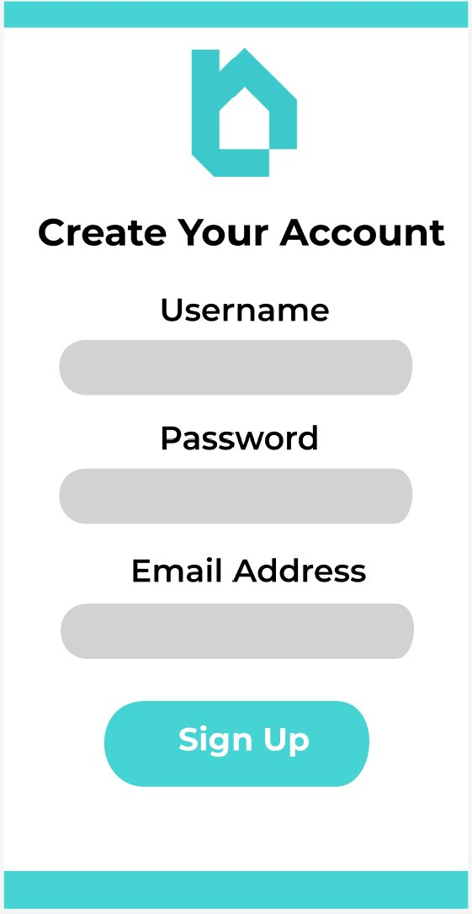
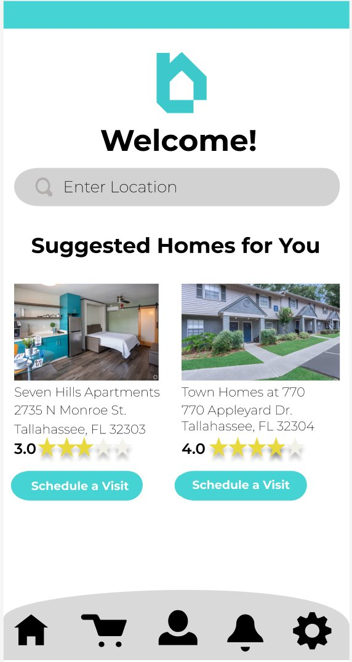




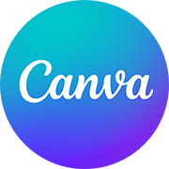

Housing AI
Isaac Royal, Essence Ochoa, Chelsa Lowery
CIS4301: Information Systems and Design Development
Introduction
Wireframes
Conclusion
Housing AI is a real estate business that makes searching for a dream home almost effortless. We are here to help customers search for their ideal home based on location, price, and personal preferences.
Here is just a small sample of what our app has to offer:
In conclusion, Housing AI not only strives to be a favorable option for finding a dream home, but also inspires to be an example to execute on a project despite outside influences, and uncontrollable circumstances in society
References
Tilley, S. (2017) Introduction to Systems Analysis and Design. In Systems Analysis and Design (12th ed.), Cengage Learning.
Schwalbe, K. (2018) Introduction to Project Management. In Information Technology Project Management (9th ed.), Cengage Learning.
Daud, F. (2020, January 22). Building a data streaming platform - how Zillow sends data to its data lake. Zillow. https://www.zillow.com/tech/building-a-data-streaming-platform/
About HousingIS. HousingIS. (n.d.). https://housingis.org/about
We are chronos. About | Chronos Interactive. (n.d.). https://www.chronosinteractive.com/about
Technology
Using the latest version of artificial intelligence, our programmers, analysts, and engineers can isolate user preferences and group all responses based on relatability. Some various software used for aspects of our project include:
NoSQL Database: MongoDB/Draw.io/Codio
Wireframes: Figma
Flyer: Canva
All Other Documents: Microsoft Office 365
Process
This project began once our business plan was approved by our professor. The very first milestone was to develop a project charter followed by a SWOT analysis, and project estimates to ensure that we were moving in the right direction. Once it was time for the second milestone, it was now time to plan our responsibilities using a work breakdown structure, and other project planning related diagrams to ensure we met our project deadline and objective. Next was the third milestone to produce valuable marketing material and begin the first stages of developing our app using various software. The final milestone was an opportunity to review our project to see if scope, time, and budget goals were met, while also finding ways to improve another version of our project in the future.

